Slide 1
Online Learning System
Kailash
Spring -2016

Slide 2
Introduction
Kailash
Spring -2016

Slide 3
Online Learning System
Online Learning System is a e-learning platform where the students and teachers can easily connect learning resources anytime , anywhere.
Creates the online learning platform which is effective for every learners.
Anyone can join the free courses with same learning experience.
Enhance the quality of learning and teaching.
All the courses are not free.

Slide 4
System Capabilities
User friendly interface
Interaction with content
Availability for different systems
Online quizzes and certifications
Share essential study materials and resources
Quick mode of delivery
Promotes active and independent learning
Facilitate on demand access

Slide 5
Problem Statement
Students struggle to adapt to the online learning environment right after the traditional classroom learning environment.
Online learning offers flexible schedule, unlike traditional courses.
Students will be able to facilitate on-demand access to learning activities.
The new system will control the following information:
Stores the study materials, books and videos
Controls the information and various other educational resources
Reduces time, cost and transportation cost.

Slide 6
Objectives
Giving all learners the same experience with the learning management system, designing to replace the traditional classroom learning environment
Making it easy to keep track of progress with learning management system
System allows students and teachers to access and securely share essential study materials and resources.

Slide 7
Hardware and software requirements
Hardware requirements
System: Pentium 4 or more for optimum performance
Hard disk: Recommended 1 GB
RAM: Minimum 2 GB
Software requirements
Operating System: Certified Distribution of Windows and MacOS
Frontend: HTML, CSS, Javascript, Bootstrap
Backend: Django
Coding language: Python

Slide 8
Object Oriented UML models

Slide 9
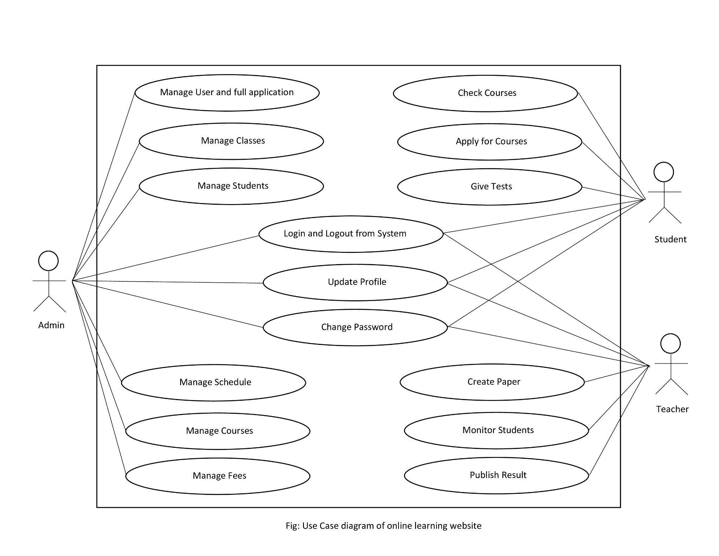
Use Case Diagram

Slide 10
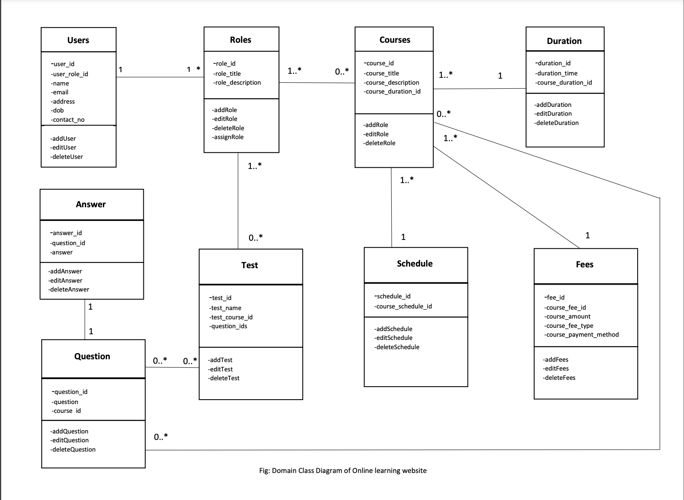
DomainClass Diagram

Slide 11
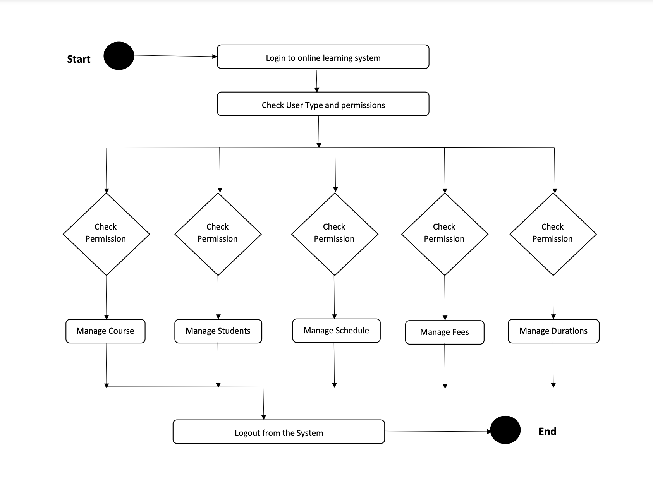
Activity Diagram

Slide 12
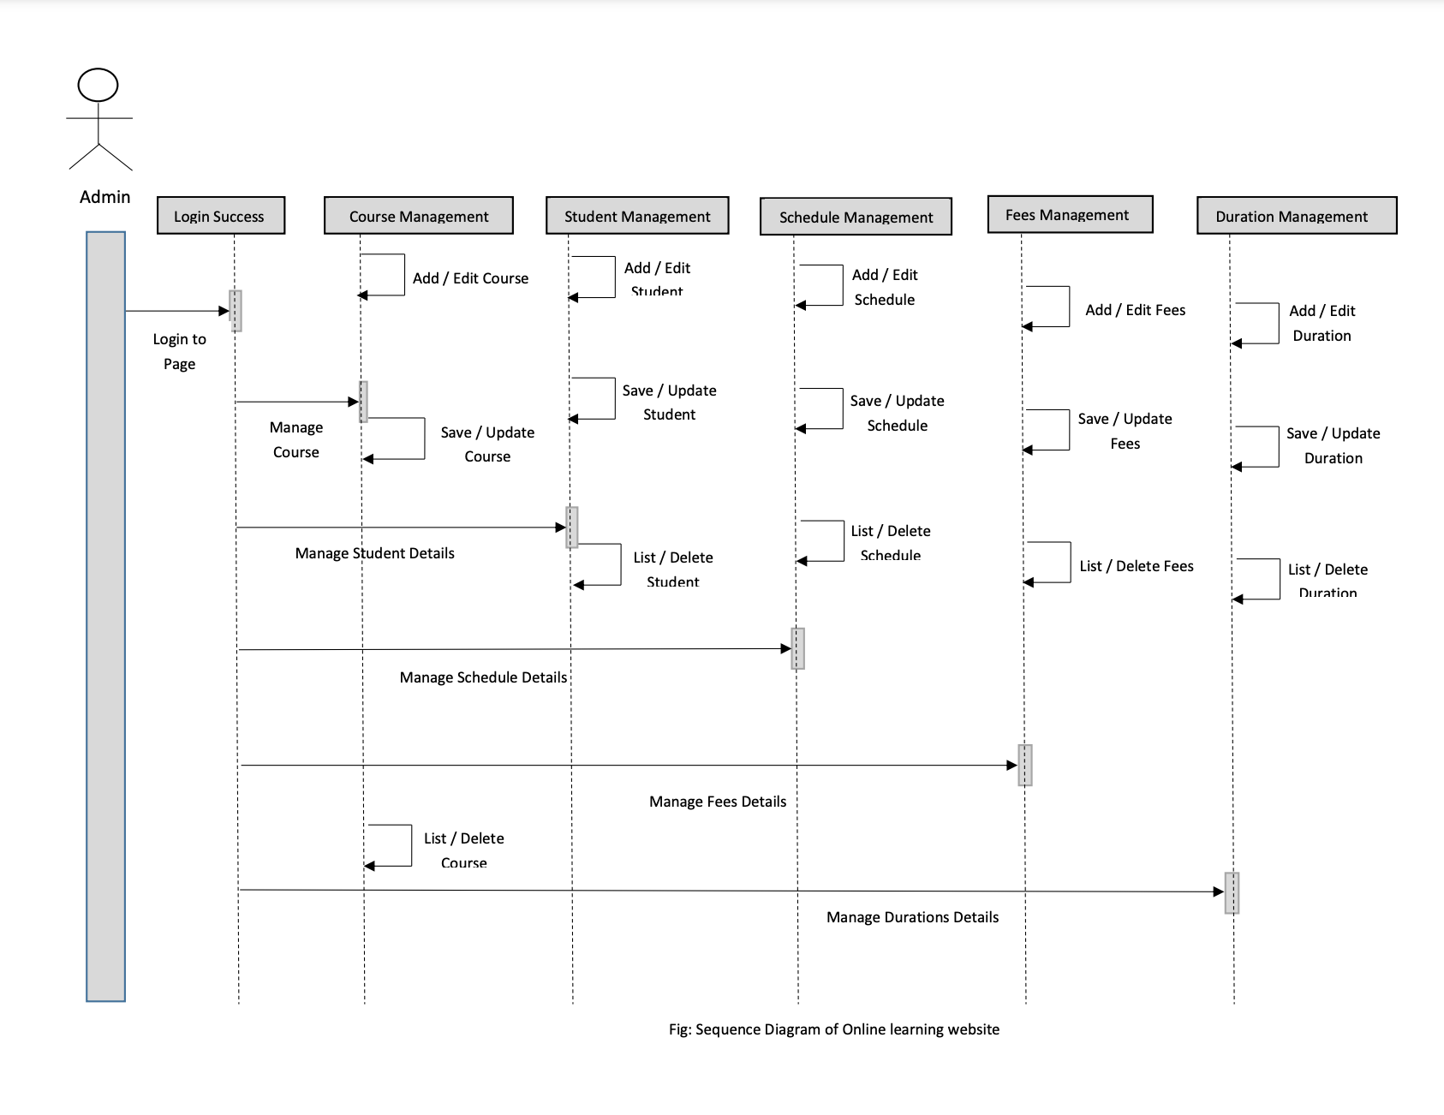
System sequence diagram

Slide 13
Implementation and results

Slide 14


Home page

Slide 15
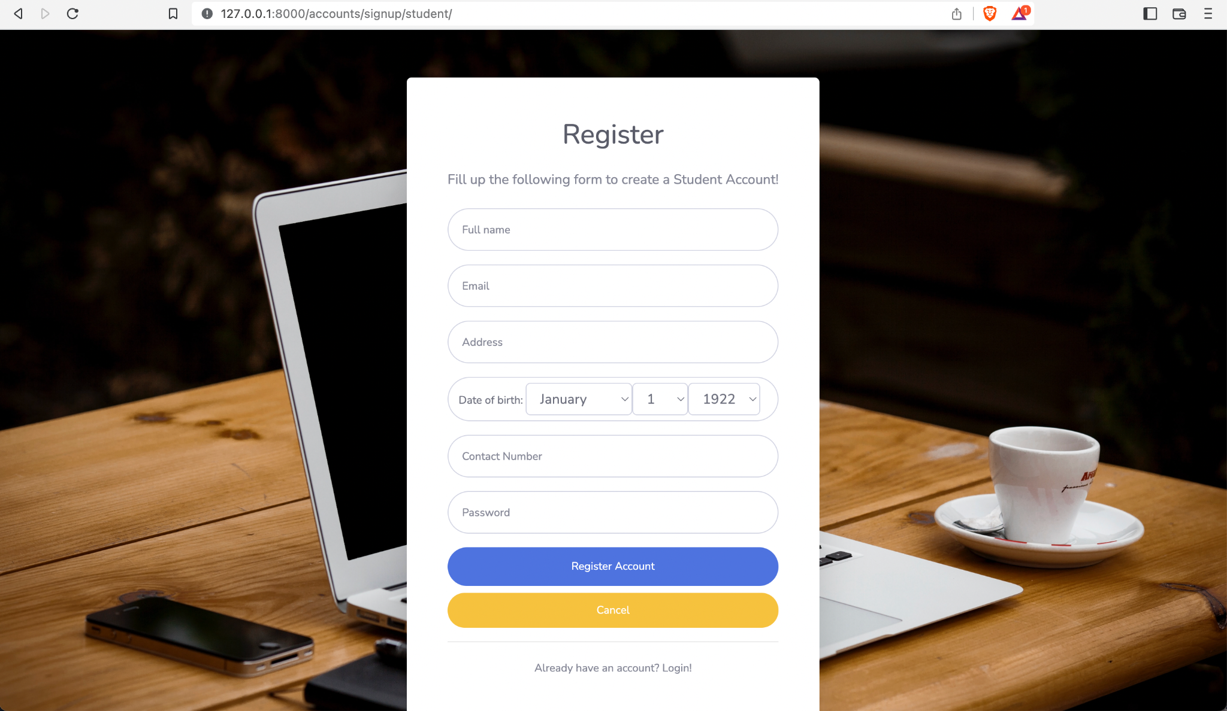
Sign up page

Slide 16
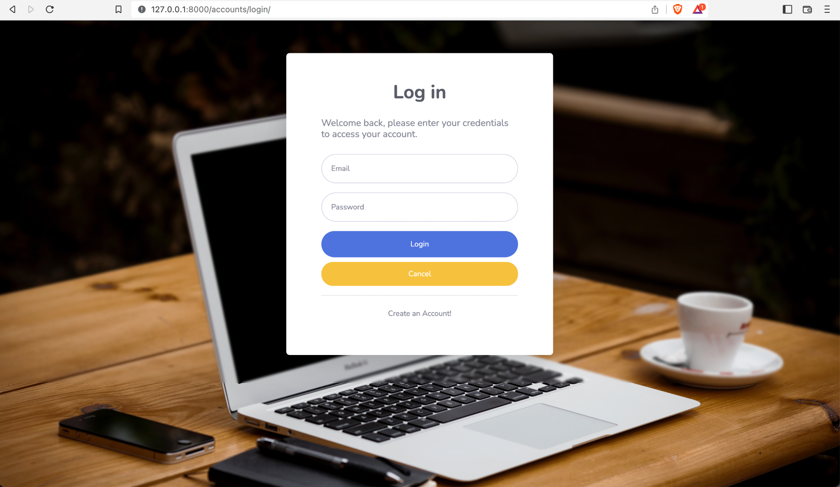
Login page

Slide 17
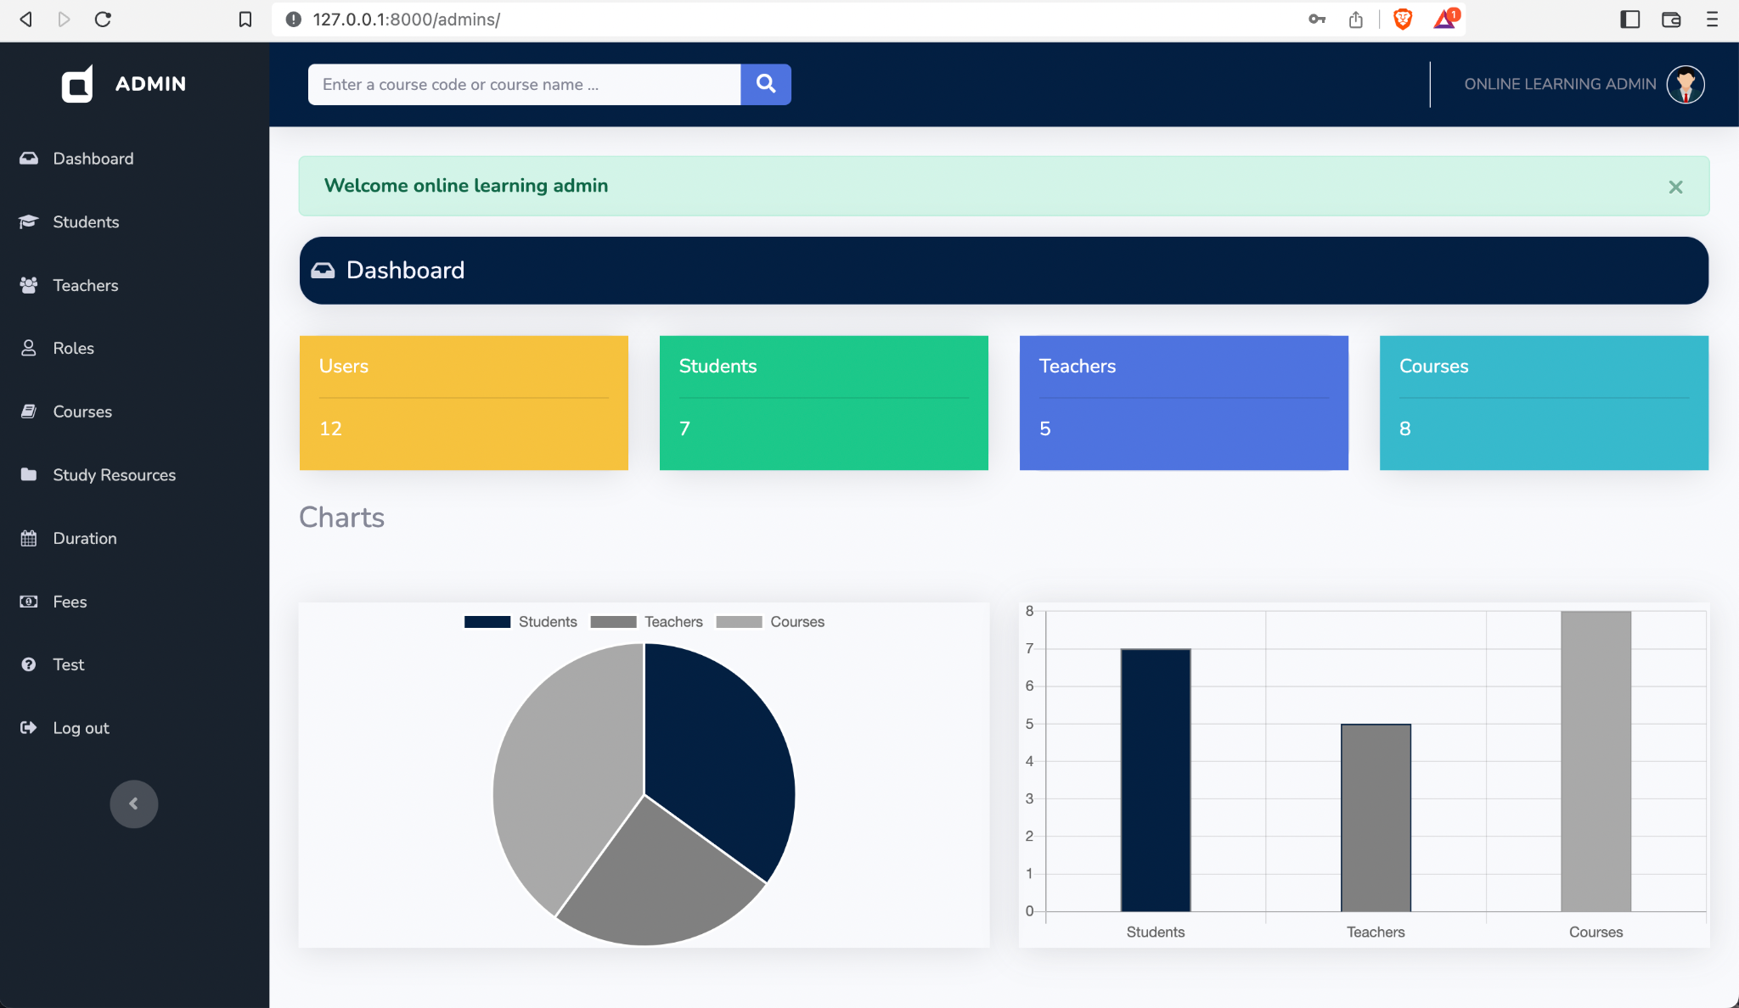
Admin
Dashboard

Slide 18
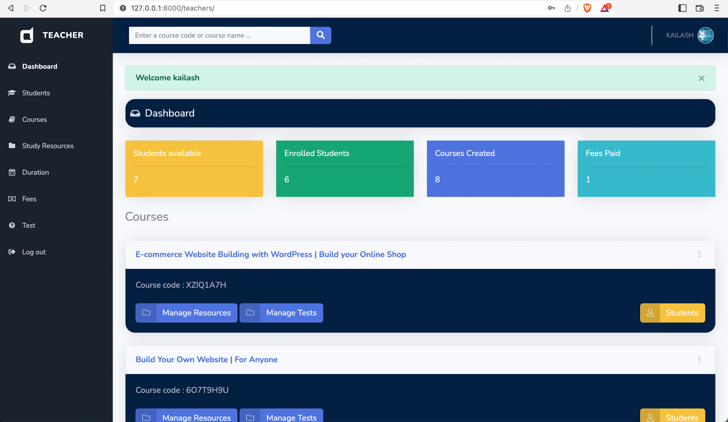
Teacher
Dashboard

Slide 19
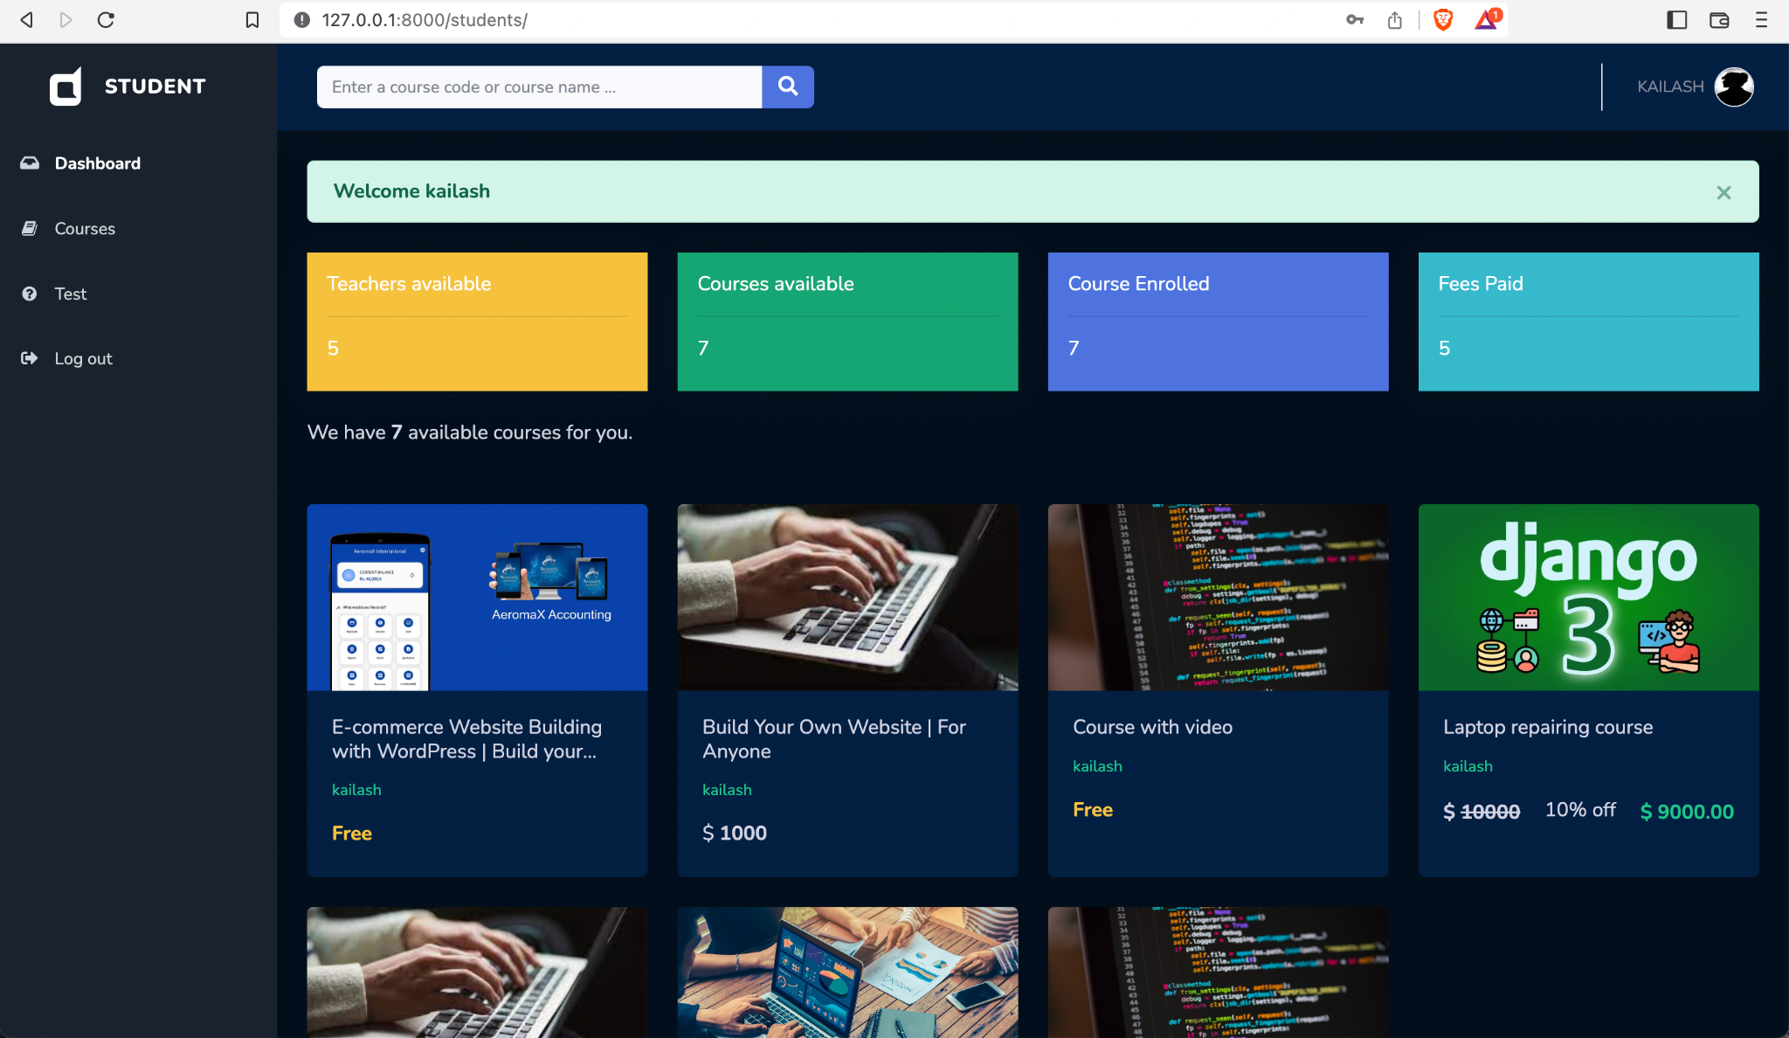
Student
Dashboard

